Slide 1

FAKE NEWS DETECTION AI SYSTEM
ERIC LUMUMBA P101/1797G/21
KARATINA UNIVERSITY MAY 2025 SUPERVISOR: MR. THOMAS NJOROGE

Slide 2
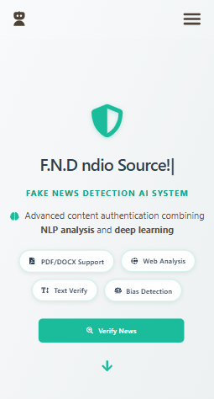
INTRODUCTION
Fake news erodes trust, impacts society.
LSTM-based AI classifies real/fake news.
Focus: Kenya’s digital media landscape.

Slide 3

PROBLEM STATEMENT
Manual fact-checking: Slow, not scalable.
Automated tools: Lack nuance (Shu et al., 2017).
Impact of fake news: Erodes trust, harms society.
This Photo by Unknown Author is licensed under CC BY-NC

Slide 4
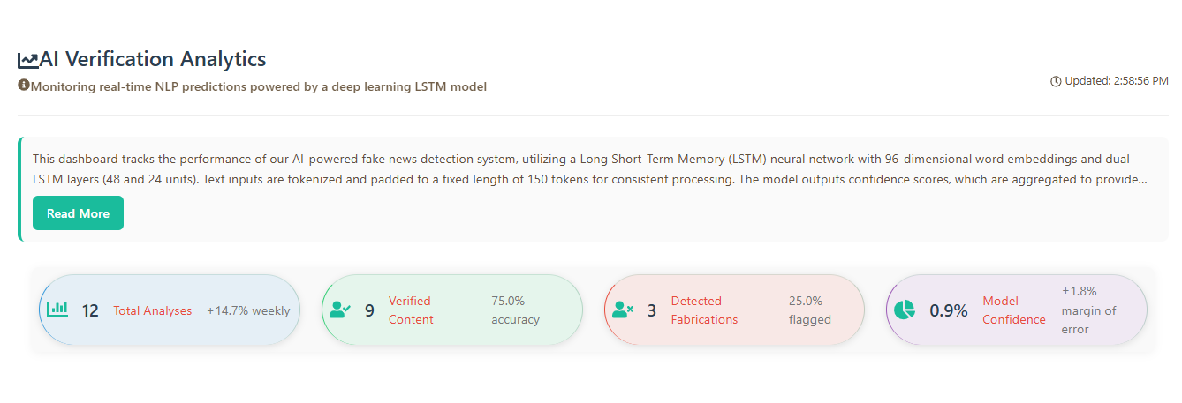
OBJECTIVES
Build 25,000-article dataset from Kaggle(fake and true csv files).
Develop LSTM model (98.95% accuracy).
Create React + Flask web app.
Evaluate performance metrics.

Slide 5
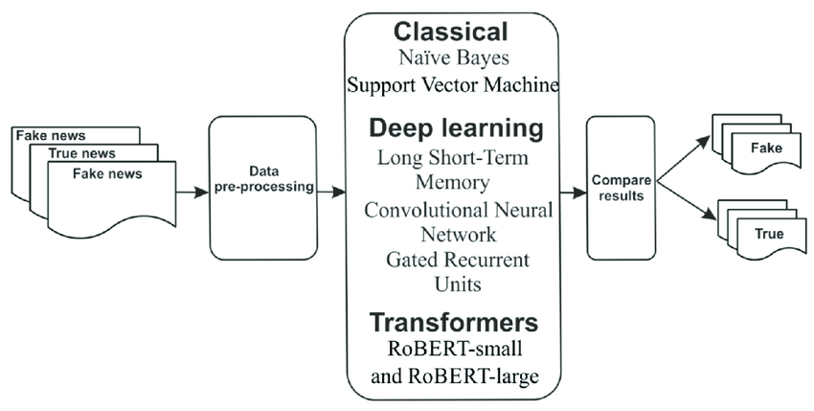
METHODOLOGY
Data: 25,000 news articles (Kaggle, Snopes).
Preprocessing: TF-IDF, NER, sentiment.
Model: Training using LSTM with SMOTE .
Tools: Python, TensorFlow, React, Flask.

Slide 6
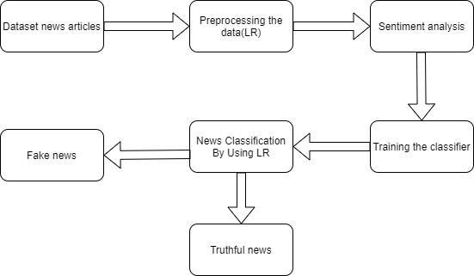
SYSTEM DESIGN
Architecture: Data, preprocessing, LSTM, UI.
Frontend: React framework for handling text/file/URL inputs.
Backend: Flask framework to connect model with frontend to predict and MySQL for database.

Slide 7
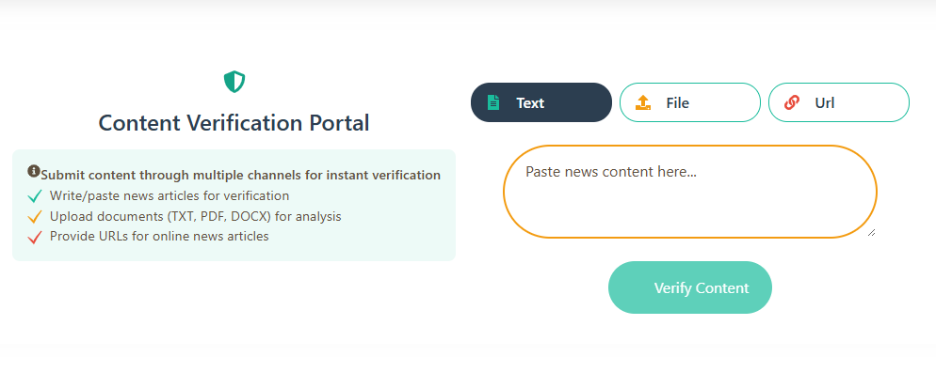
IMPLEMENTATION
Backend: Flask /predict, LSTM integration.
Frontend: Content Verification portal, ContentAuthentication.tsx screenshots
<motion.button type="submit" className={styles.analyzeButton}>
Verify Content
</motion.button>

Slide 8
RESULTS
LSTM: 98.95% accuracy, high F1-score.
Outperforms Random Forest (92.5%).
UI: Real-time, user-friendly.

Slide 9
LIMITATIONS & CONCLUSION
Limitations: Dataset biasness, time constraints.
Conclusion: High-accuracy system by LSTM algorithm would work well for news content filtering in Kenya and world wide.
Pros: High accuracy Cons: Biasness in datasets and time constraints

Slide 10
RECOMMENDATION AND Q&A
Use of larger, diverse datasets.
Add multilingual support.
References: Allcott & Gentzkow (2017).
Questions?
Multilingual Support
Real-Time Features

